Slide 1
What does the literature reveal about the risk for Malignant Hyperthermia?
Mark Keskes, Julie Ivey, Nathan Buchinger,
Caroline Haugen, and Elizabeth Berkemeier
Ferris State University
Nursing 350

Slide 2
Topic: Malignant Hyperthermia
Our topic for research is “What does the literature reveal about the risk for Malignant Hyperthermia when intubated with a potentially reactive agent?”
Are patients who are intubated (P) using Succinylcholine, Desflurane, Isoflurane, Halothane, or Sevoflurane (I) at increased risk for Malignant Hyperthermia (O) compared with patients who are intubated using a non-reactive agent (C) during their intubation?

Slide 3
Our Aim for This Project
In this research project, critical appraisal and critique was performed on four major journal articles regarding malignant hyperthermia (MH), and their weighted outcomes will be discussed. Research was gathered from previous research studies, and evidence was analyzed. Evidence found was compiled and analyzed for barriers to implementation and means to make the application of the findings possible.
The evidence found that incorporation is vital. In the ICU and PACU, nurses must be made aware of potentially harmful signs and medications that will trigger MH.

Slide 4
What is Malignant Hyperthermia?
Malignant Hyperthermia is a potentially fatal "pharmacogenetic disorder of skeletal muscle that presents as a hypermetabolic response to potent volatile anesthetic gases such as halothane, sevoflurane, desflurane and the depolarizing muscle relaxant succinylcholine, and rarely, in humans, to stresses such as vigorous exercise and heat" (Rosenberg, Davis, James, Pollock, & Stowell, 2007, p. 1).

Slide 5
Signs of Malignant Hyperthermia
"Classic signs of MH include hyperthermia to a marked degree, tachycardia, tachypnea, increased carbon dioxide production, increased oxygen consumption, acidosis, muscle rigidity, and rhabdomyolysis, all related to a hypermetabolic response" (Rosenberg, Davis, James, Pollock, & Stowell, 2007, p. 1).

Slide 6
Introduction of Problem
The focus of the problem of MH that will be researched in this paper is whether certain individuals that are genetically susceptible to this disorder, who are administered desflurane, isoflurane, halothane, succinylcholine, and sevoflurane, will cause the individual to have sustained muscle contraction leading to increased thermoregulation, which the body is unable to dispel.

Slide 7
Introduction of Problem (cont.)
When medication administration occurs to certain individuals, will changes occur to the metabolic state of the individual?
This topic is broad based and has major implications for nursing, patient safety outcomes, and future research needs.

Slide 8
Support for Relevance
Why does this matter?
The perioperative nurse plays a key role in recognizing and responding to an MH emergency (Hommertzheim & Steinke, 2006)
Mortality from MH has dropped from 80% 35 years ago to <5% from research and education (Rosenberg, Davis, James, Pollock, & Stowell, 2007)
Patients are intubated using succinylcholine in a variety of nursing settings, even prehospital
Understanding how and why certain anesthetics cause MH may help prevent future occurrences and reveal areas needing further research

Slide 9
Our Choice of Relevant Articles
Database search terms:
PubMed - "malignant, hyperthermia, trigger"
NIH Library - "malignant hyperthermia, susceptibility, non, volatile"
Each group member picked from among the dozens of generated results
A list of ten articles was compiled and voted on by the group
These articles were evaluated using the following criteria:
Research design with high level of evidence
Strong correlation to PICO statement
Quantitative design
Current (less than 15 years old)
Clear and concise abstract
The following four articles were chosen for review based on these criteria and group consensus

Slide 10
Summary of Article 1
"Future directions in malignant hyperthermia research and patient care“
2011 Article from the journal Anesthesia & Analgesia
Summary of the 2010 scientific conference sponsored by the Malignant Hyperthermia Association of the United States (MHAUS)
Topics discussed in the article:
pathophysiology of MH
genetic testing for MH susceptibility
the relationship between MH susceptibility and other muscle disorders
MH epidemiology
future directions in clinical practice
educational initiatives and MH-related research

Slide 11
Summary of Article 1 (cont.)
Points from article related to PICO statement
Acute episodes of MH generally precipitated by inhalation of strong anesthetics and/or succinylcholine
If a freestanding facility does not use volatile anesthetics or succinylcholine, it is not required to have an MH plan or supplies
MH susceptibility (MHS) linked to mutation in the gene for skeletal muscle ryanodine receptor (RyR1)
RyR1 functions to help supply the myoplasmic Ca²⁺ for contraction
RyR1 mutation may lower threshold of activation of threshold of
Ca²⁺ channel by volatile anesthetics, thus triggering MH
RyR1 mutation, combined with volatile anesthetic, can lead to MH
Determining MHS by analyzing RyR1 genes is difficult and time consuming
More than 200 RyR1 variants associated with MH susceptibility with only 30 considered to be causal

Slide 12
Critique of Article 1
Quantitative Research
Non-experimental Design
Meta-Analysis of current research on MH
Highest level of evidence
Qualified and well-educated Authors
Note: no nurses authored article
Presented in peer-reviewed scholarly journal
Abstract concise with purpose identified
Easy to read and terms defined
Patient centered focus
Conclusion shows meaning of research

Slide 13
Summary of Article 2
"Malignant Hyperthermia"
2007 article from the Orphanet Journal of Rare Diseases
In 2007 90 mutations of the ryanodine receptor (RYR-I) gene at chromosome 19q13.1 had been found and 25 of those are considered to be causal. People with Central Core Disease and Multi-Minicore Disease are considered to be a part of this group of gene disorders.
Diagnostic testing done with caffeine & halothane at limited centers.
Many different kinds of genetic testing are being evaluated
no one test 100% accurate in predicting MH susceptibility
Thought that 1:50,000-100,000 was the population that was at risk, however it has been shown that in French descendants 1:3000 are at risk.
Mortality from MH <5% down from >80% thirty years prior from study and awareness.
Differential diagnosis should always be considered
Prevention: a Good H&P

Slide 14
Critique of Article 2
Quantitative Research
Non-experimental Design
Meta-analysis of research done on MH
Qualified, scholarly, authors
Nurses not involved in authoring articles
Presented in a well-respected rare disease journal
Abstract clear and concise and summarizes article
Technical verbiage used, and well clarified throughout article
Conclusion of article determines that further research on MH is necessary

Slide 15
Summary of Article 3
"Malignant hyperthermia: Pharmacology of triggering“
2011 Article published in British Journal of Anaesthesia
Review of evidence from studies regarding triggering mechanisms for MH, including volatile inhalation agents, succinylcholine, and other drugs implicated as triggers of MH, as well as cellular mechanisms of action in MHS patients
Points from the article:
Dose-dependence related to severity of MH reaction has been reported but not well-established
Succinylcholine, when given alone, has not been adequately shown to cause MH, but does potentiate MH reactions when given with an inhalation agent
Delay of onset - Although all inhalation agents have been shown to trigger MH, halothane and isoflurane trigger MH faster than enflurane and sevoflurane (see next slide)

Slide 16
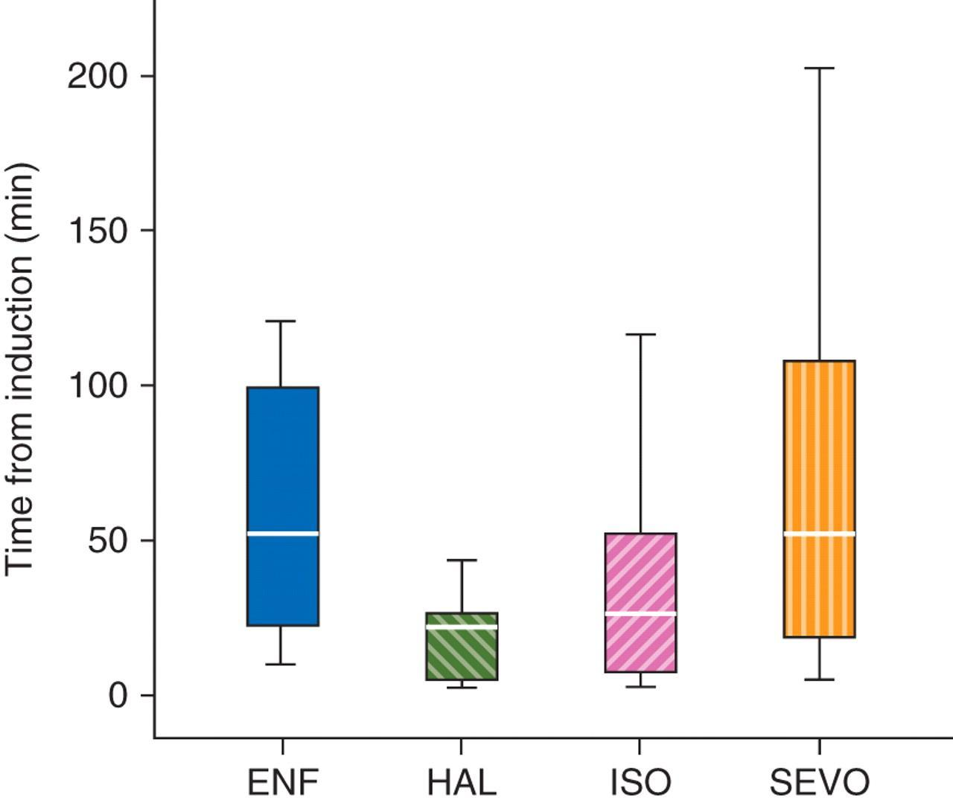
Box and whisker plot of the time from induction of anaesthesia to the onset of MH in 73 patients (eight received enflurane, 11 halothane, 42 isoflurane and 12 sevoflurane).
Hopkins P M Br. J. Anaesth. 2011;107:48-56
© The Author [2011]. Published by Oxford University Press on behalf of the British Journal of Anaesthesia. All rights reserved. For Permissions, please email: journals.permissions@oup.com
Notes:
Box and whisker plot of the time from induction of anaesthesia to the onset of MH in 73 patients (eight received enflurane, 11 halothane, 42 isoflurane and 12 sevoflurane). The boxes delineate the inter-quartile range, the white horizontal line within the box is the median value, and the whiskers indicate the range. Using a general linear regression model, there was a statistically significant faster onset of the MH reaction with halothane vs enflurane and sevoflurane but not isoflurane.
Box and whisker plot of the time from induction of anaesthesia to the onset of MH in 73 patients (eight received enflurane, 11 halothane, 42 isoflurane and 12 sevoflurane). The boxes delineate the inter-quartile range, the white horizontal line within the box is the median value, and the whiskers indicate the range. Using a general linear regression model, there was a statistically significant faster onset of the MH reaction with halothane vs enflurane and sevoflurane but not isoflurane.

Slide 17
Summary of Article 3 (cont.)
Other non-anesthetic drugs have been reported to have negative effects on MHS individuals
Statins caused increased rhabdomyolysis in three MHS patients, but more evidence is needed
Tetracaine triggered an MH type response when used as a spinal block, although this could have been due to hyponatremia
Ondansetron was implicated by one study to have caused a fatal MH reaction in a known MHS child; the author shows, however, that the child's RYR1 variant had been known to cause fatal reactions in two other MHS patients without pharmacological triggers. Ondansetron, therefore, should not be implicated.
Thiopental, an IV-induction drug, has been shown to delay the onset of MH in MHS pigs, but has not been studied in this way in humans.
Non-depolarizing neuromuscular blocks (NDNMB) used in MHS pigs have also delayed onset of MH and lowered serum creatinine kinase post-anesthesia.
Preliminary data from a recent study corroborate the protective properties of NDNMBs in MH human patients.

Slide 18
Summary of Article 3
The author includes a review of newly learned mechanisms of action of
potent inhalational agents in MHS patients
Potent inhalational agents
"overcome the inhibitory regulatory effect of magnesium ions on the ryanodine receptor protein [RyR1]." This contributes to development of MH
increase the action potential of skeletal muscle cells by causing an influx of calcium through a depletion of intracellular calcium
This may help in understanding why succinylcholine contributes to a heightened risk of MH in MHS patients
"This review has highlighted the capacity for all potent inhalation anaesthetics to trigger MH and the role of succinylcholine in inducing early muscle rigidity and enhancing the response to inhalation drugs. The ability of succinylcholine to initiate a life-threatening metabolic MH reaction as the sole trigger is doubtful. There is no convincing evidence to support the restriction of other drugs in MH-susceptible patients" (Hopkins, 2011, p. 54).

Slide 19
Critique of Article 3
Quantitative Research
Non-experimental Design
Meta-analysis of case studies done on MH
Highly respected author published in British Journal
Abstract states clearly about topic of interest
Illustrations explain concepts surrounding MH
Article is understandable, easy to decipher
Hypothesis is clearly stated
Conclusion is well-defined, and findings are clearly stated regarding succinylcholine

Slide 20
Summary of Article 4
"Sevoflurane as a potential replacement for halothane in diagnostic testing for malignant hyperthermia susceptibility: results of a preliminary study."
2011 article from Menerva Anesthesiologica
"Volatile anesthetics and succinylcholine trigger an abnormal increase of intracellular calcium levels" causing Muscle contractures (Metterlein, Hartung, Schuster, Roewer, Anetseder, 2011, p. 768).
Sevoflurane, a volatile anesthetic, is compared to halothane, the most potent trigger for MH in determining susceptibility
in MH.
In-vitro contracture test (IVCT) and caffeine halothane contracture test (CHCT) used.
Susceptibility to MH can be assumed if the measured contracture exceeds 0.2g for IVCT or 0.5g for CHCT

Slide 21
Summary of Article 4 (cont.)
30 different muscle fibers from different patients were analyzed.
The tests were conducted with sevoflurane instead of the "Gold Standard" halothane in the next set of tests.
Increments of sevoflurane for test one and bolus of sevoflurane 8% for test two.
"All volatile anesthetics are potent MH triggers. However, the specific potency to clinically trigger MH varies with the substance used" (Metterlein, Hartung, Schuster, Roewer, Anetseder, 2011, p. 770).
Genetic screening and CHCT needed to diagnose true MH.
Sevoflurane was found to be more effective in bolus 8% than in increments.

Slide 22
Critique of Article 4
Quantitative Research
Quasi-Experimental: Nonequivalent Control Group Design
Experimental testing on muscle fibers for MH susceptibility
Qualified, scholarly authors
No nurse authors
Presented in well respected German Journal
Abstract provides background, methods, results, and conclusion
Technical terms defined and thoroughly discussed.
Aim and hypothesis clearly defined.
Conclusion determines that a large number of patients and a genetic test are needed in future modified tests

Slide 23
Application of Evidence
Barriers to the application of the findings: The dose is undetermined for triggering MH and nurses often do not use volatile anesthetic gases.
Bridges to application of these findings: *Anesthesia medications used in surgery can trigger MH and it can take up to 210 minutes for onset.
*Succinylcholine is often used for
intubations which occur in ICUs and many
other areas in the hospital in emergencies.

Slide 24
Summary of Literature Review
This literature review has revealed the following related to our PICO:
MH susceptibility is due to a genetic mutation
This mutated part of the MHS patient's genes responds to all of the inhalation agents used for anesthesia
Each of the PICO's four inhalation agents and IV succinylcholine trigger MH but are dose dependent and bring on MH symptoms at different times after administration
The mechanism of action on MHS patient's muscle cells is complex yet more is being learned about how these agents work at the cellular level
Muscle contraction related to calcium and magnesium influx and regulation is altered when MHS patients are exposed to these drugs
There is little evidence in the literature about non-reactive anesthetics (like propofol or nitrous oxide) causing MH or MH-like symptoms when used for intubation
Patients often do not know they are susceptible to MH until an anesthetic gas or depolarizing muscle relaxant is used, or about the signs and symptoms of MH, the antidote dantrolene sodium, and triggers such as succinylcholine.

Slide 25
Incorporation into Practice
The evidence can be incorporated into practice in every department in hospitals where intubations occur
Often, the drug of choice for intubations is succinylcholine, which can trigger an MH episode.
Non-reactive medications such as propofol or nitrous oxide should be considered as alternative anesthetics when an intubation is required and/or if MHS is unknown.
There should be dantrolene readily available and location known to treat MH symptoms.
Nurses caring for peri- and post-intubated patients must be made aware of medications that trigger MH and interventions to quickly treat those who show signs of MH.

Slide 26
Future Research
Opportunities for future research or evidence-based application in nursing practice:
Education for peri-intubation nurses in recognition of MH and resources for MH treatment
Nursing interventions, practices or standards of care that will increase detection of MH and improve outcomes
Nursing interventions, practices or standards of care that will decrease morbidities and mortality secondary to MH
Other areas for scientific research of MH:
Genetic research that delves deeper into why MH patients react to inhalation agents
Chemical research that studies the properties of reactive agents that create an MH response
Pharmaceutical innovation and research working toward the development of an inhaled anesthetic that does not cause MH

Slide 27
References
Hirshey Dirksen, S. J., Larach, M. G., Rosenberg, H., Brandon, B. W., Parness, J.,
Lang, R. S., . . . & Pezalski, T. (2011). Future directions in malignant hyperthermia research and patient care. Anesthesia & Analgesia, 113(5), 1108-1119. doi:10.1213/ANE.0b013e31822af2e
Hommertzheim, R., & Steinke, E. E. (2006). Malignant hyperthermia: The
perioperative nurse's role. AORN Journal, 83(1), 149-156.
Hopkins, P. M. (2011). Malignant hyperthermia: Pharmacology of triggering.
British Journal of Anaesthesia, 107(1), 48-56. doi:10.1093/bja/aer132
Metterlein, T., Hartung, E., Schuster, F., Roewer, N., & Anetseder, M. (2011). Sevoflurane
as a potential replacement for halothane in diagnostic testing for malignant
hyperthermia susceptibility: Results of a preliminary study. Menerva Anestesiologica,77(8), 768-73.
Rosenberg, H., Davis, M., James, D., Pollock, N., Stowell, K. (2007). Malignant
hyperthermia. Orphanet Journal of Rare Diseases, 2, 21. doi:10.1186/1750-1172-2-21

Slide 28
Other Reviewed Non-cited Works
Allen, G. C., Brubaker, C. L. (1998). Human malignant hyperthermia associated withdesflurane anesthesia. Anesthesia & Analgesia, 86(6), 1328-1331. Retrieved from http://www.anesthesia-analgesia.org/content/86/6/1328.long
Claxton, B. A., Cross, M. H., & Hopkins, P. M. (2002). No response to trigger agents in
a malignant hyperthermia‐susceptible patient. British Journal of Anesthesia, 88(6),
870-873. doi:10.1093/bja/88.6.870
Glahn, K. P. E., Ellis, F. R., Halsall, P. J., Muller, C. R., Snoeck, M. M., Urwyler, A.,
Wappler, F. (2010). Recognizing and managing a malignant hyperthermia crisis:
Guidelines from the European Malignant Hyperthermia Group. British Journal of Anaesthesia, 105(4), 417-420. doi:10.1093/bja/aeq243.
Larach, M. G., Hershey Dirksen, S. J., Belani, K.G., Brandom, B. W., Metz, K. M.,
Policastro, M. A., . . . Watson, C. B. (2012). Creation of a guide for the transfer of
care of the malignant hyperthermia patient from ambulatory surgery centers to receiving hospital facilities. Anesthesia & Analgesia, 114(1), 94-100. Retrieved from http://www.anesthesia-analgesia.org/content/114/1/94.long

Slide 29
Other Reviewed Non-cited Works
Rosenberg, H., Sambuughin, N., Riazi, S., & Dirksen, R. (2013). Malignant
hyperthermia susceptibility. In R. A. Pagon, T. D. Bird, C. R. Dolan, et al. (Eds.),
GeneReviews. Seattle: University of Washington. Retrieved from: http://www.ncbi.nlm.nih.gov/books/NBK1146/

